Slide 1
Structural Patterns in Practice: Adapter, Decorator, and Facade
Improving Code Flexibility and Maintainability
Presenter: Wu Tang

Slide 2
Introduction to Structural Patterns
Definition: Structural design patterns explain how to assemble objects and classes into larger structures while keeping these structures flexible and efficient.
Key Concept: They rely heavily on Object Composition (wrapping objects inside other objects) rather than Class Inheritance.
Why they matter:
  They decouple the abstraction from implementation.
  They make systems easier to scale.
  They allow for changes in relationships between entities at runtime.

Slide 3

Pattern 1 – The Adapter Pattern
Making Incompatible Interfaces Compatible
Key Points:
Purpose: Allows objects with incompatible interfaces to collaborate. It acts as a bridge between two objects.
Real-world Analogy: If you buy a laptop in Europe and travel to the US, you need an adapter. The adapter doesn't change the electricity; it changes the shape of the interface so the socket allows power to flow.
Software Application:
  Using a legacy data XML system when your new application requires JSON.
  Wrapping a 3rd party library so it matches your domain code.
Mechanic: The Adapter implements the interface expected by the client and wraps the instance of the class that has the incompatible interface
(A picture of a Travel Power Plug Adapter (UK to US))

Slide 4
Adapter Code Example
Goal: Show how we "wrap" a Euro plug to look like a US Socket.
// 1. The Target Interface (What the client expects)
interface USSocket {
void plugInUSA();
}
// 2. The Adaptee ( The incompatible class)
class EuroLaptop {
void plugInEuro() { System.out.println("Euro Power Connected"); }
}
// 3. The Adapter (Translates the calls)
class TravelAdapter implements USSocket {
private EuroLaptop device; // Composition
public TravelAdapter(EuroLaptop device) {
this.device = device;
}
@Override
public void plugInUSA() {
// Calls the incompatible method internally
device.plugInEuro();
}
}

Slide 5
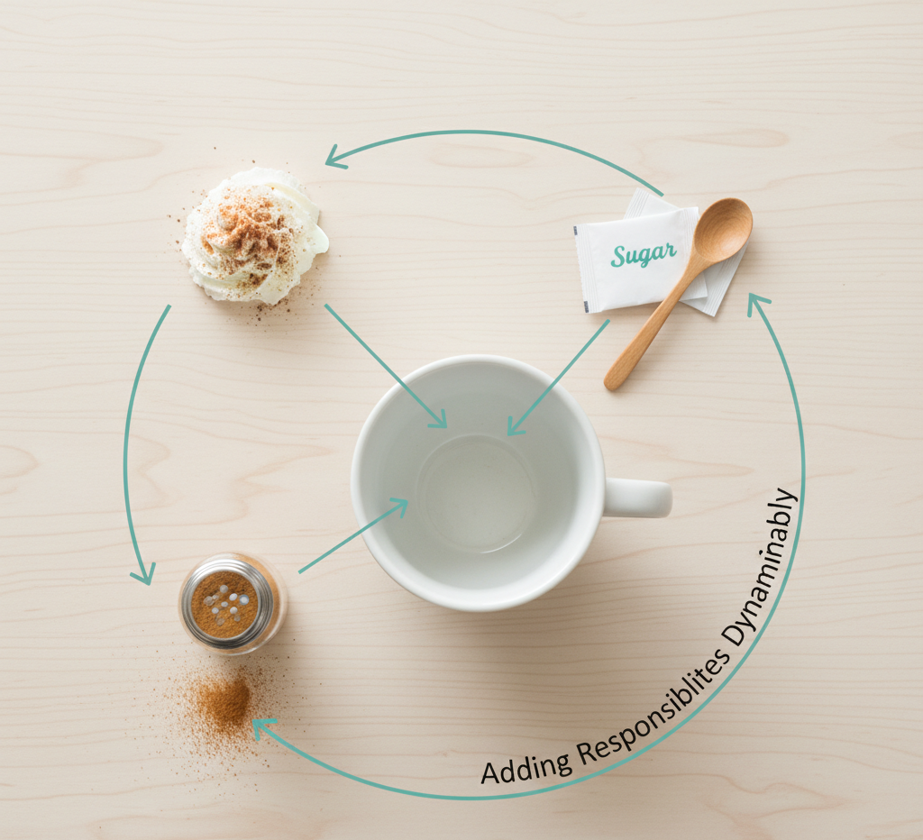
Pattern 2 – The Decorator Pattern
Adding Responsibilities Dynamically
Key Points:
Purpose: Attaches new behaviors to an object at runtime by wrapping it inside a "wrapper" object.
Key Principle: The Open/Closed Principle. Classes should be open for extension, but closed for modification.
Software Application:
  Java I/O Streams (new BufferedReader(new InputStreamReader(System.in))).
  UI toolkits (Adding a "Scrollbar" to a "TextBox").
Alternative to Subclassing: Prevents an "explosion" of subclasses (e.g., textWithBorderAndScrollbarAndShadow). You just decorate the base object.
(A basic coffee cup with arrows pointing to add-ons (whip cream, sugar, cinnamon) or Russian Matryoshka dolls.)

Slide 6
Decorator Code Example
Goal: Show how we calculate the cost of coffee + milk without changing the original Coffee class.
// 1. The Interface
interface Coffee {
double getCost();
}
// 2. The Base Implementation
class SimpleCoffee implements Coffee {
public double getCost() { return 5.00; }
}
// 3. The Decorator (Adds functionality)
class MilkDecorator implements Coffee {
private Coffee coffee; // Stores the object being decorated
public MilkDecorator(Coffee coffee) {
this.coffee = coffee;
}
public double getCost() {
// Adds its own cost (1.50) to the wrapped object's cost
return this.coffee.getCost() + 1.50;
}
}
// Usage: new MilkDecorator(new SimpleCoffee()); // Returns 6.50

Slide 7

Pattern 3 – The Facade Pattern
Simplified Interface to a Complex Subsystem
Key Points:
Purpose: Provides a simplified interface to a library, a framework, or any other complex set of classes.
Benefits:
  Reduces dependencies between the client and the complex system.
  Isolates complexity.
Software Application:
  A VideoConverter class that hides the complex logic of codecs, bitrates, and audio buffers behind a simple convert(filename, format) method.
  Interacting with a complex database API.
(A complicated car engine covered by a simple hood with a single "Start" button.)

Slide 8
Facade Code Example
Goal: Show how 3 complex system calls are hidden behind 1 simple method.
// 1. The Complex Subsystems (The "Mess")
class DVDRom { void load() { ... } }
class Projector { void turnOn() { ... } }
class SurroundSound { void setVolume(int v) { ... } }
// 2. The Facade ( The Simple Button)
class HomeTheaterFacade {
private DVDRom dvd = new DVDRom();
private Projector projector = new Projector();
private SurroundSound audio = new SurroundSound();
// One simple method calls the complex subsystem
public void watchMovie() {
dvd.load();
projector.turnOn();
audio.setVolume(5);
System.out.println("Movie started easily!");
}
}

Slide 9
Comparison – Don't Confuse Them!
Content (Table):
Pattern | Goal | Key characteristic
Adapter | Compatibility | Converts one interface to another so they fit.
Decorator | Extensibility | Adds extra responsibilities/behaviors without changing code.
Facade | Simplicity | Simplifies a complex interface (wraps many classes into one).
Note: All three are "Wrappers," but their intent is what differentiates them.

Slide 10
Conceptual Question
Q1: What is the primary difference between the Adapter and the Decorator pattern?
Q2: Which SOLID principle is the primary driver for the Decorator pattern?
Answer: The Adapter pattern is used to make incompatible interfaces work together (changing the interface), whereas the Decorator pattern is used to add new behaviors or responsibilities to an object dynamically (keeping the interface the same).
Answer: The Open/Closed Principle. It allows you to extend an object's behavior (open for extension) without modifying the original class source code (closed for modification).

Slide 11
Question based scenario
Q3: You have a complex system with 50 classes for video processing. You want junior developers to be able to use this system without understanding the underlying complexity. Which pattern should you use?
Q4: True or False: The Adapter pattern typically wraps a "legacy" class to look like a "modern" class.
Answer: The Facade Pattern. It creates a single entry point that handles the delegation to the complex subsystem.
Answer: True. It adapts the interface of the "legacy" class (adaptee) to match the "target" interface expected by the modern client.

Slide 12
Summary & Best Practices
Composition over Inheritance: Structural patterns generally prefer object composition (wrapping) over inheritance. This makes systems less rigid.
Don't Overuse: Do not wrap objects just for the sake of it.
  Use Facade when the system is too complex.
  Use Adapter when you can't change existing code to fit new needs.
  Use Decorator when you need many combinations of features.

Slide 13
Q&A / Discussion
Floor open for questions.
References:
  "Design Patterns: Elements of Reusable Object-Oriented Software" (Gang of Four)
  "Clean Code" by Robert C. Martin

